Slide 1

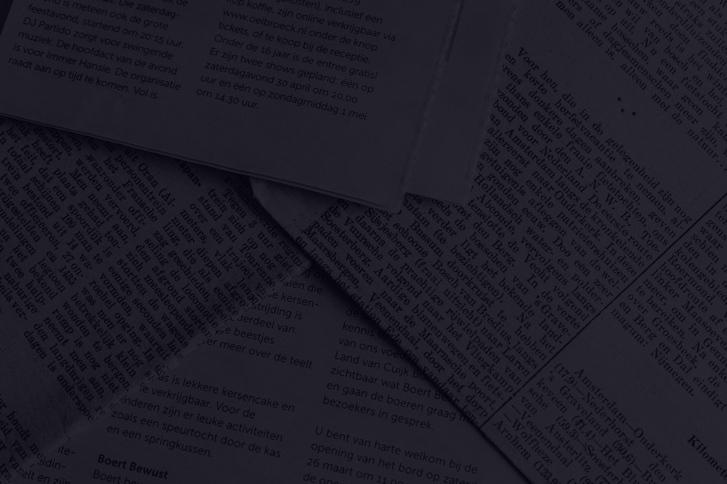
NATURAL LANGUAGE PROCESSING
FINE TUNING PRETRAINED LLM

Slide 2
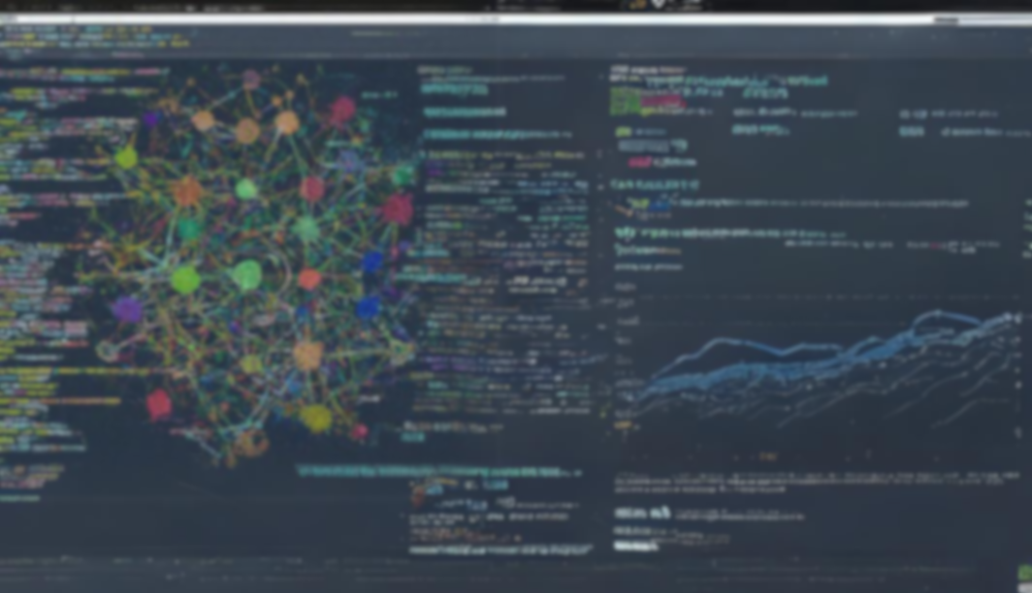
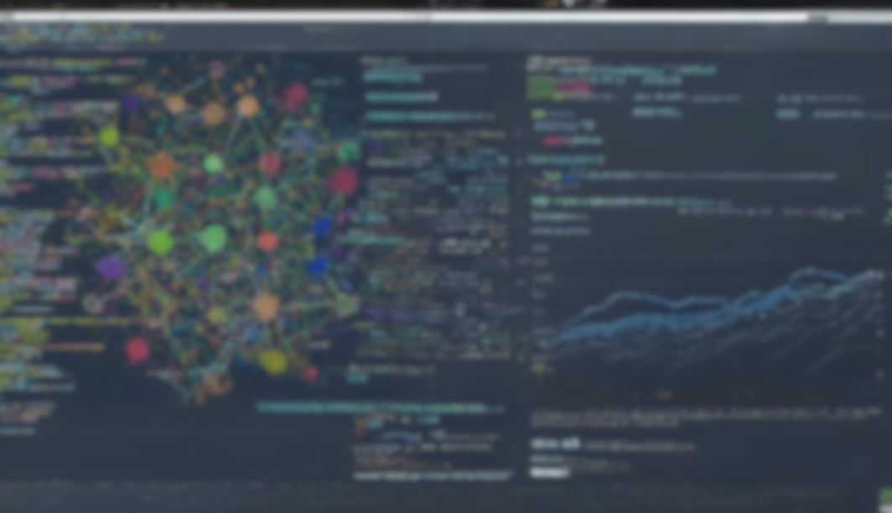

FINE TUNING PRETRAINED LLM

Slide 3
  Fine-tuning is the process of adjusting the parameters of a pre-trained large language model to a specific task or domain.
  Although pre-trained language models like GPT possess vast language knowledge, they lack specialization in specific areas.
  Fine-tuning addresses this limitation by allowing the model to learn from domain-specific data to make it more accurate for targeted applications.
FINE TUNING LLM

Slide 4
  By exposing the model to task-specific examples during fine-tuning, the model can acquire a deeper understanding of the nuances of the domain.
  This bridges the gap between a general-purpose language model and a specialized one, unlocking the full potential of LLMs in specific domains or applications.
LLM FINE-TUNING

Slide 5
  Select a pre-trained model
  Gather relevant Dataset
  Preprocess Dataset
  Fine-tuning
STEPS INVOLVED IN LLM FINE-TUNING

Slide 6
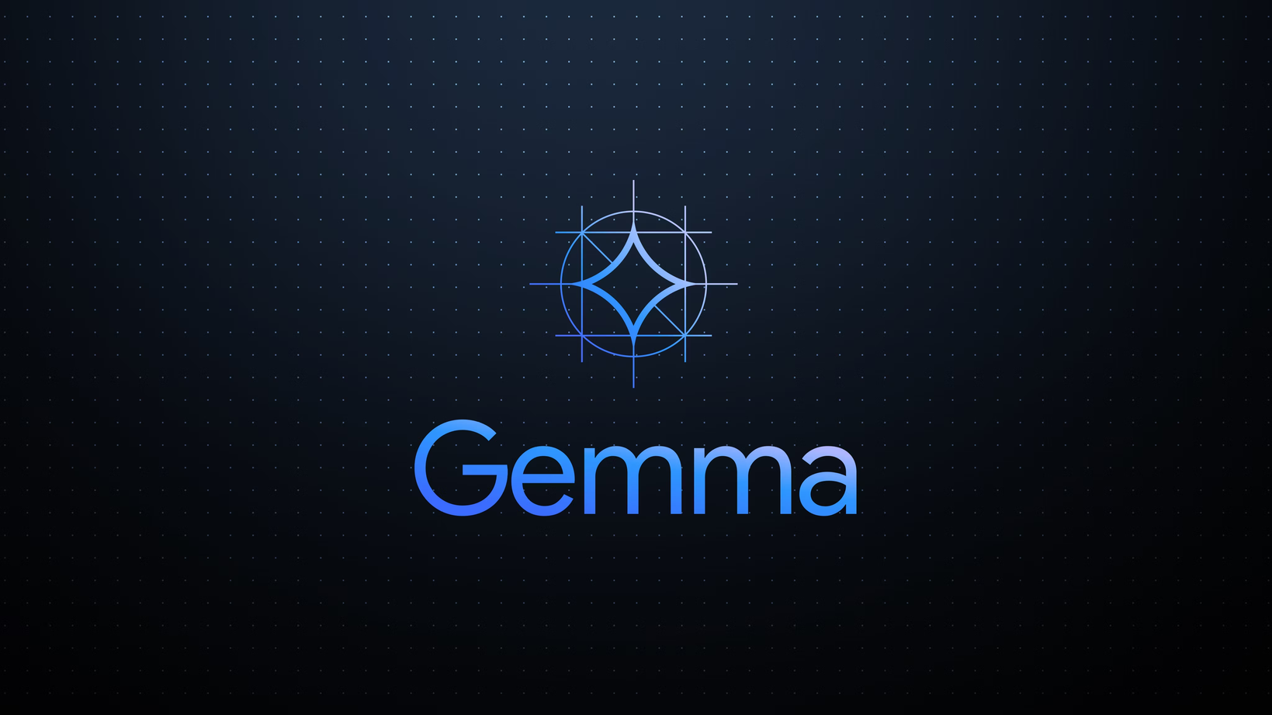
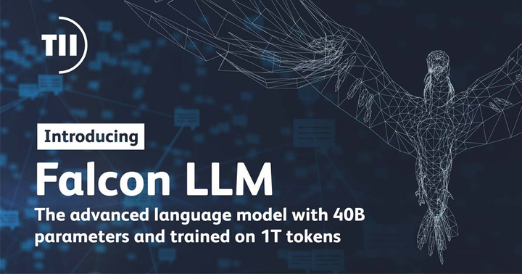

  For LLM Fine-tuning first step is to carefully select a base pre-trained model that aligns with our desired architecture and functionalities.
  Pre-trained models are generic purpose models that have been trained on a large corpus of unlabeled data.
SELECT A PRE-TRAINED MODEL

Slide 7
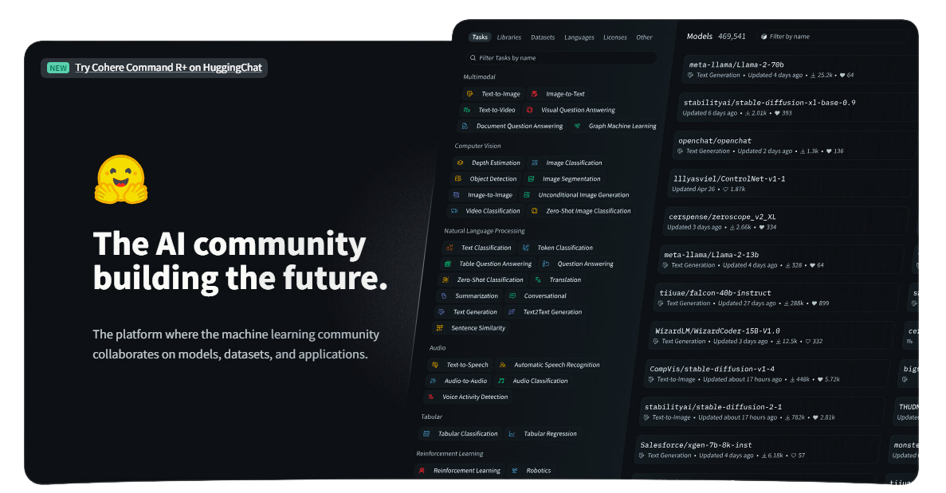

HUGGING FACE

Slide 8
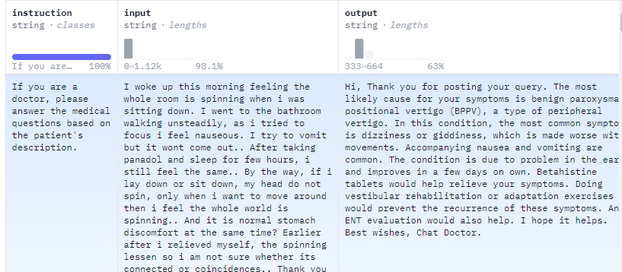
  Then we need to gather a dataset that is relevant to our task.
  The dataset should be labeled or structured in a way that the model can learn from it.
GATHER RELEVANT DATASET

Slide 9
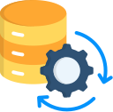
  Once the dataset is ready, we need to do some preprocessing for fine-tuning by cleaning it, splitting it into training, validation, and test sets, and ensuring it’s compatible with the model on which we want to fine-tune.
PREPROCESS DATASET

Slide 10

  After selecting a pre-trained model we need to fine tune it on our preprocessed relevant dataset which is more specific to the task at hand. The dataset which we will select might be related to a particular domain or application, allowing the model to adapt and specialize for that context.
FINE TUNING

Slide 11
  Full Fine Tuning (Instruction fine-tuning)
  Parameter Efficient Fine-Tuning (PEFT)
FINE TUNING METHODS

Slide 12
  Instruction fine-tuning is a strategy to enhance a model’s performance across various tasks by training it on examples that guide its responses to queries.
  The choice of the dataset is crucial and tailored to the specific task, such as summarization or translation.
  This approach, known as full fine-tuning, updates all model weights, creating a new version with improved capabilities.
FULL FINE TUNING (INSTRUCTION FINE-TUNING)

Slide 13
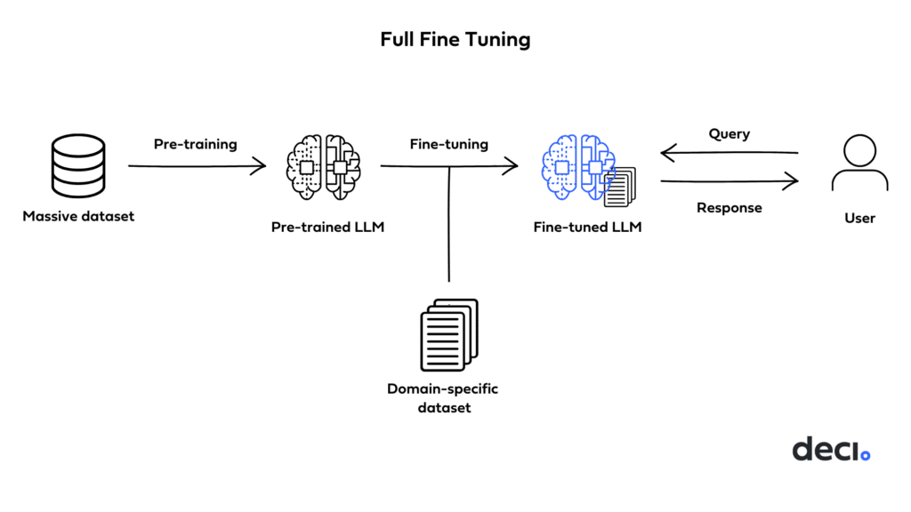
  However, it demands sufficient memory and computational resources, similar to pre-training, to handle the storage and processing of gradients, optimizers, and other components during training.
FULL FINE TUNING (INSTRUCTION FINE-TUNING)

Slide 14
  Parameter Efficient Fine-Tuning (PEFT) is a form of instruction fine-tuning that is much more efficient than full fine-tuning.
  Training a language model, especially for full LLM fine-tuning, demands significant computational resources.
  Memory allocation is not only required for storing the model but also for essential parameters during training, presenting a challenge for simple hardware.
PARAMETER EFFICIENT FINE-TUNING (PEFT)

Slide 15
  PEFT addresses this by updating only a subset of parameters, effectively “freezing” the rest.
  This reduces the number of trainable parameters, making memory requirements more manageable and preventing catastrophic forgetting. Unlike full fine-tuning, PEFT maintains the original LLM weights, avoiding the loss of previously learned information.
PARAMETER EFFICIENT FINE-TUNING (PEFT)

Slide 16
  This approach proves beneficial for handling storage issues when fine-tuning for multiple tasks.
  There are various ways of achieving Parameter efficient fine-tuning.
  Low-Rank Adaptation LoRA & QLoRA are the most widely used and effective.
PARAMETER EFFICIENT FINE-TUNING (PEFT)

Slide 17
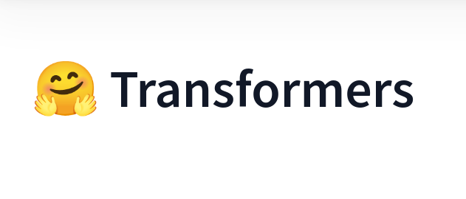
HUGGING FACE TRANSFORMERS LIBRARY

Slide 18



  The Hugging Face Transformer Library is an open-source library that provides a vast array of pre-trained models primarily focused on NLP.
  It’s built on PyTorch and TensorFlow, making it incredibly versatile and powerful.
HUGGING FACE TRANSFORMERS LIBRARY

Slide 19
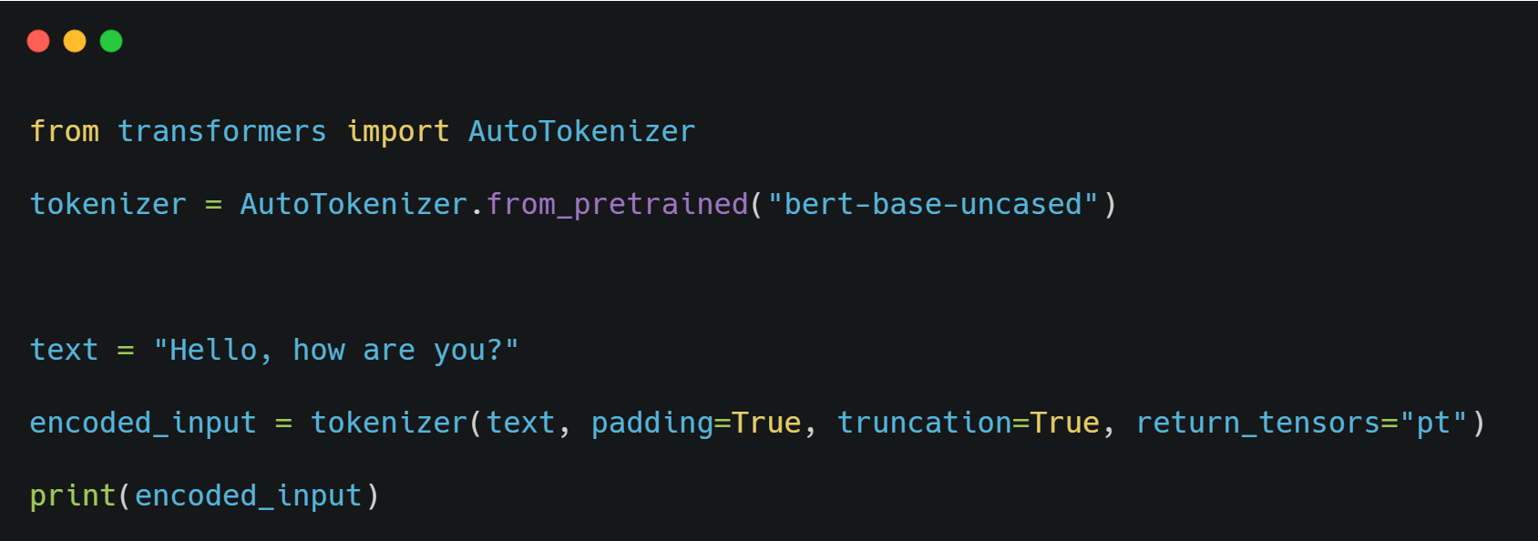
  The tokenizer API is used to preprocess text data and tokenize it into input features for transformer models.
TOKENIZER API

Slide 20
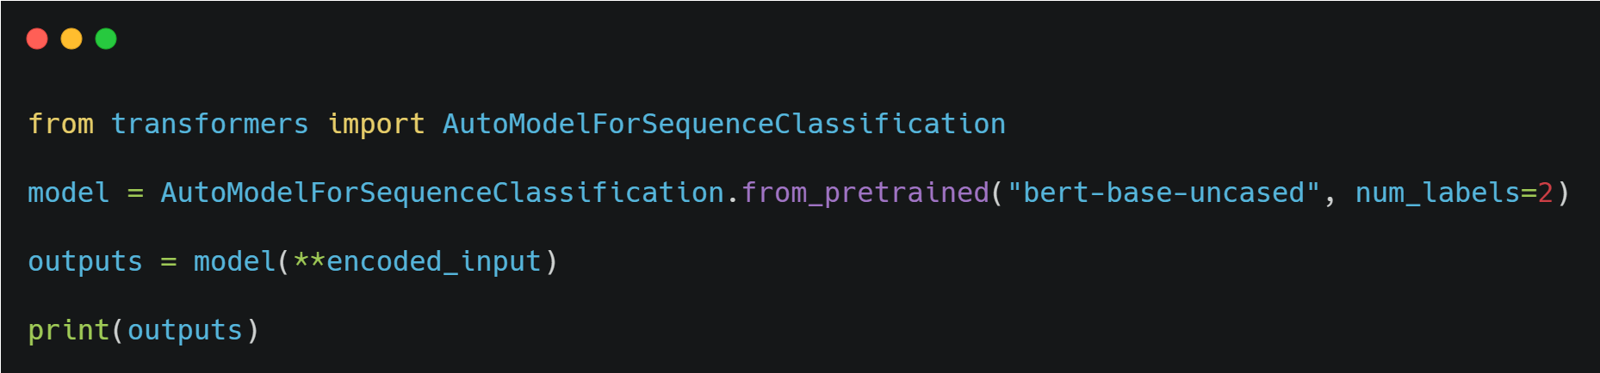
  The model API allows you to load pre-trained transformer models for various NLP tasks.
MODEL API

Slide 21
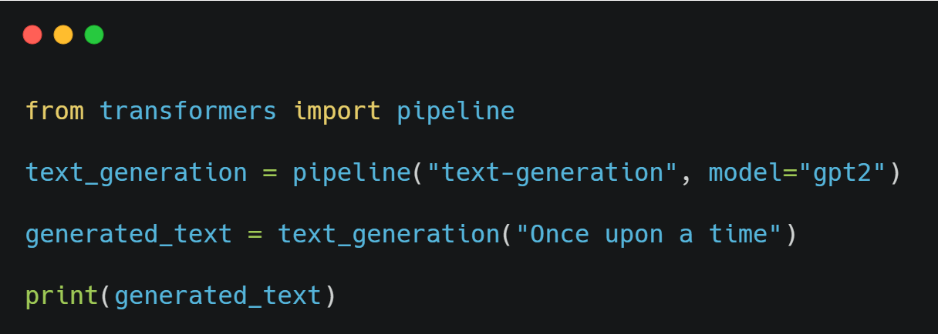
  The pipeline API simplifies the process of using pre-trained models for specific tasks like text generation, question-answering, sentiment analysis, etc.
PIPELINE API

Slide 22
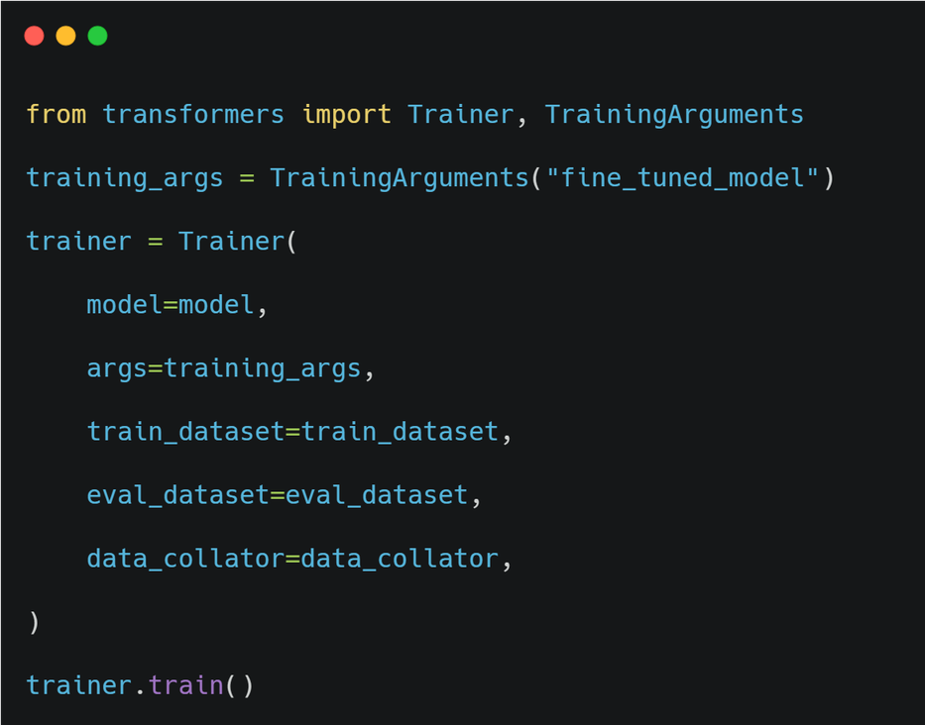
  The trainer API helps you fine-tune pre-trained models on custom datasets for specific tasks.
TRAINER API

Slide 23
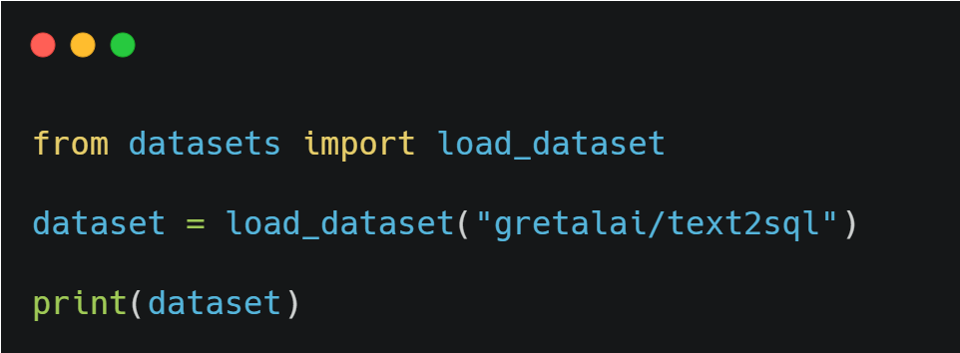
  The datasets API allows you to load and preprocess various datasets for NLP tasks.
DATASETS API

Slide 24
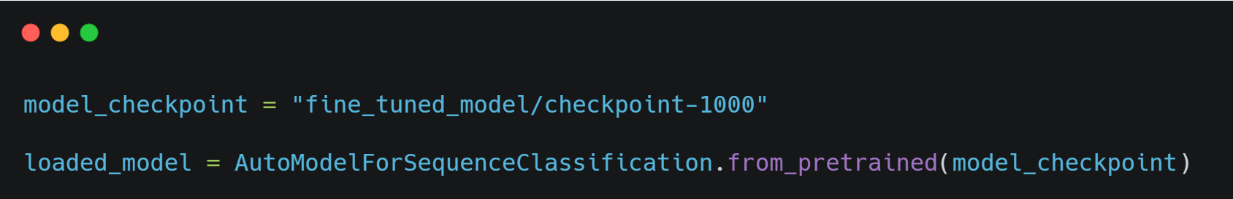
  You can load a pre-trained model checkpoint and resume training or use it for inference.
LOAD CHECKPOINT

Slide 25
  You can load a pre-trained model checkpoint and resume training or use it for inference.
LOAD CHECKPOINT

Slide 26
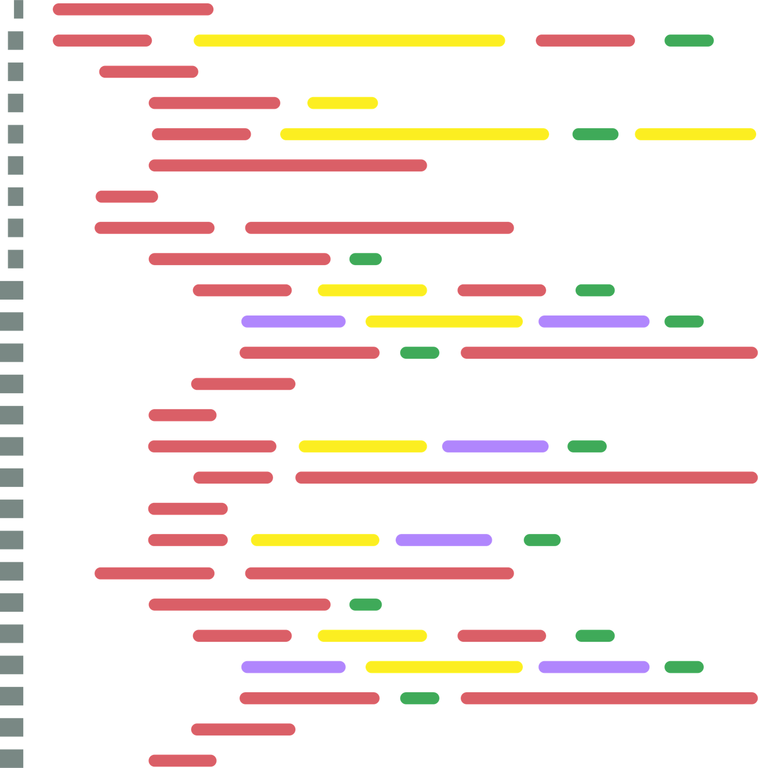
HANDSON

Slide 27

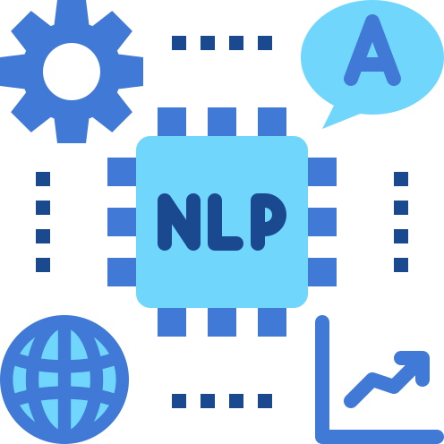
1 MONTH CERTIFIED INTERNSHIP
NLP (NATURAL LANGUAGE PROCESSING)

Slide 28

BENEFITS OF INTERNSHIP
  30 DAYS OF RECORDED SESSIONS
  30 DAYS OF PRESENTATION FOR DOWNLOAD
  10 PROJECT SOURCE CODES FOR DOWNLOAD
  1 MONTH INTERNSHIP CERTIFICATE
  PARTICIPATION CERTIFICATE
  90 DAYS OF ACCESS TO COURSES
  4 HACKATHON LIVE SESSIONS
  COMMUNITY GROUP

Slide 29
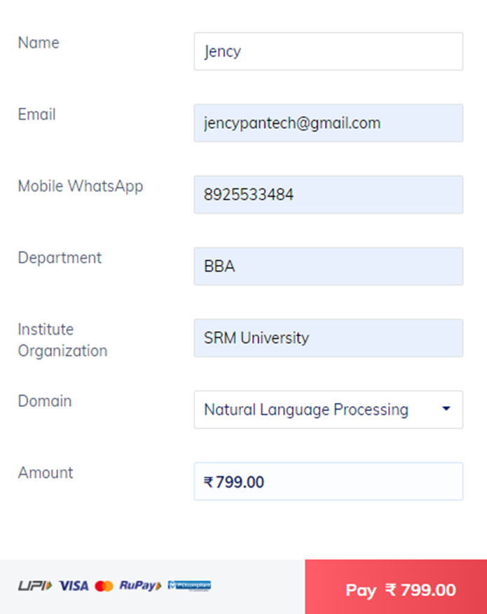
1 MONTH INTERNSHIP
REG FEE : RS.1999
DISCOUNTED FEE : RS.799
REG LINK - HTTPS://RZP.IO/L/UEQE4WM
JOIN AS INTERNSHIP USER
NLP INTERNSHIP

Slide 30
DAY WISE LEARNING PLAN
DAY 1 : INTRODUCTION TO NLP, AND MACHINE LEARNING
Day 2 : Data collection, Pandas Library
Day 3 : Numpy library
Day 4 : Matplotlib, Seaborn
Day 5 : Machine learning basics, preprocessing
Day 6 : Encoding, Outlier detection, handling
Day 7 : Train test split, feature selection
Day 8 : Machine learning Modeling, model evaluation
Day 9 : ML Classification project - Churn prediction
Day 10 : ML Regression project - Sale prediction for a FMCG company

Slide 31
DAY WISE LEARNING PLAN
DAY 11 : CLUSTERING PROJECT - MALL CUSTOMER CLUSTERING
Day 12 : Regex
Day 13 : Text preprocessing -1 : Tokenization, Lemmatization, Stop words
Day 14 : Text preprocessing -2: POS, NER, Bag of Words, TFIDF, Ngrams,
Day 15 : Sentiment Classification on Amazon Reviews using Machine Learning
Day 16 : Introduction to Deep learning, Tensorflow basics
Day 17 : Advanced preprocessing - word2vec, average word2vec.
Day 18 : Advanced preprocessing implementation
Day 19 : RNN , LSTM architecture walkthrough
Day 20 : Next word Prediction using LSTM

Slide 32
DAY WISE LEARNING PLAN
DAY 21 : GENERATING POETIC TEXT USING LSTM
Day 22 : Fake News Classifier using Bidirectional LSTM
Day 23 : Seq2Seq Models
Day 24 : Text Summarization using LSTM encoder-decoder architecture
Day 25 : LLM introduction, Transformer Architecture
Day 26 : Hugging Face, Fine tuning a pretrained model on custom dataset
Day 27 : LangChain, Chat with Books and PDF Files with Llama 2 and Pinecone
Day 28 : Blog Generation LLM app using Llama 2
Day 29: SQL Query LLM using Google Gemini
Day 30 : Youtube Video Transcribe Summarizer LLM App With Google Gemini

Slide 33

YOU CAN REGISTER FOR OUR 4 IN 1 BUNDLE OFFER
PYTHON
MACHINE LEARNING
NLP
GENERATIVE AI

Slide 34
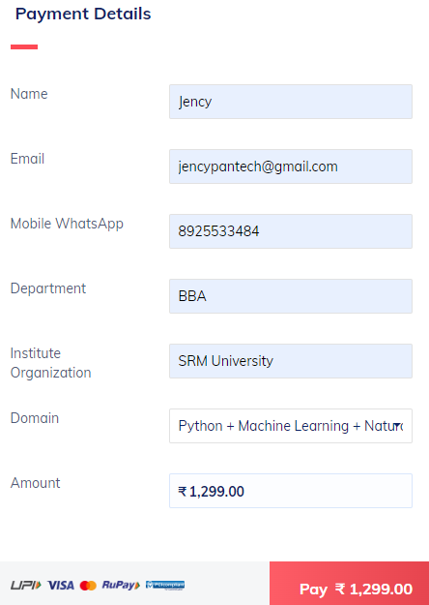
4 IN 1 BUNDLE OFFER
REGISTRATION FEE: RS.1299
REG.LINK - HTTPS://RZP.IO/L/DPWKJUI
FEE: RS.1299
LIMITED OFFER ONLY/-

Slide 35
BENEFITS OF THE OFFER
  SELF-PACED 120 RECORDS
  WEEKLY LIVE SESSIONS
  4 CERTIFICATIONS - 1 MONTH INTERNSHIP CERTIFICATION
  30+PROJECTS
  DOWNLOADABLE PRESENTATIONS
  INTERNSHIP CONFIRMATION LETTER
  1 YEAR VALIDITY
  COMMUNITY SUPPORT

Slide 36
THANK YOU

